Slide 1
GOALS OF EDUCATION
PEACE AND EQUALITY
RIGHT TO LIVE IN PEACE
RIGHT TO BE EDUCATED
DET- Development Education Talk

Slide 2
Malala Yousafzai
July 12, 1997
Swat District of Pakistan
DET- Development Education Talk

Slide 3
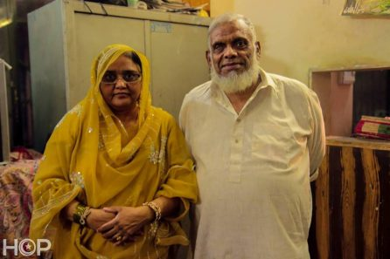
HUNGRY FOR EDUCATION
DET- Development Education Talk

Slide 4
DET- Development Education Talk

Slide 5
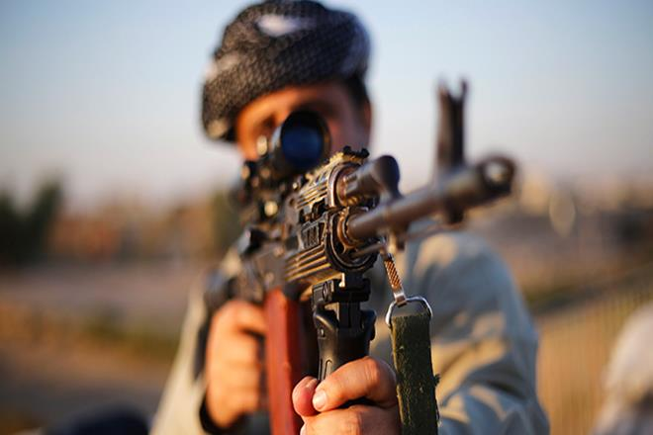
DET- Development Education Talk

Slide 6
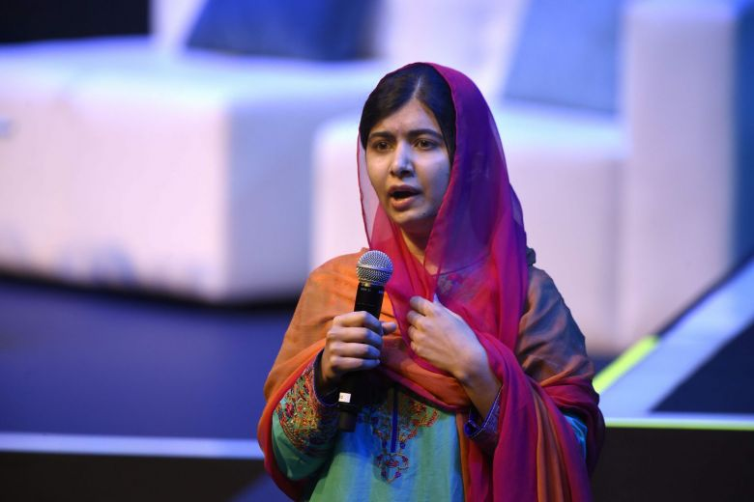
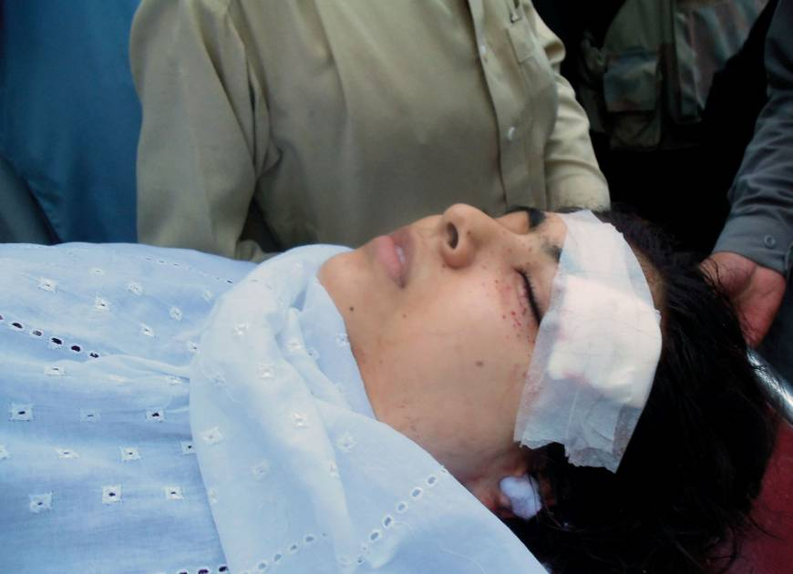
2007
Passion
9th of October 2012
DET- Development Education Talk

Slide 7
With guns you can kill terrorists, with education you can kill terrorism.
DET- Development Education Talk

Slide 8
DET- Development Education Talk

Slide 9
Education is the only solution. Education First.
DET- Development Education Talk

